Slide 1
Secure Web Programming
Lecture 3. Server-side Scripting
Amanda.Lunt@utas.edu.au
Soonja.Yeom@utas.edu.au

Slide 2
Topics
Secure Web Programming
Week13
Review
Basic Web Programming
Web Security
Adv. Web Programming
Fundamentals – protocol, CS model, etc.
HTTP Protocols, Storage
Advanced Web Applications
Human Computer Interaction with Web Page Design
Security Issues and Technologies
Session management
Client-side Scripting Language and Document Object Model
Secure Programming and Users
Common Gateway Interface
Server-side Scripting Language and Privilege configuration
Encryption and Authentication
Advanced Security Issues

Slide 3
Review: Web Scripting Language
Web Scripting provides the type of instructions for the web browser. It usually run within a browser.
Two major scripting languages:
Client-side scripting language (learned last week) - JavaScript, Action-Script, Dart, VBScript
Server-side scripting language - ASP, JSP, PHP, Python, Ruby, Server-side JavaScript

Slide 4


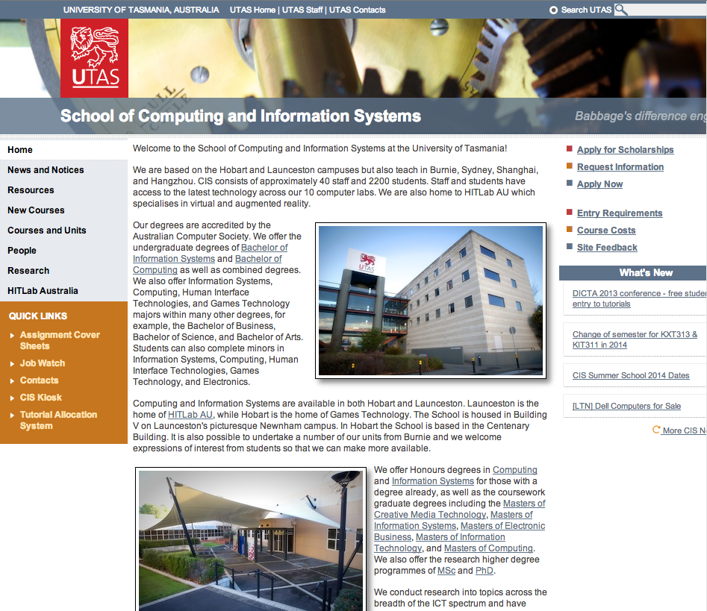
Review: Client-side vs Server-side
Client-side : script is executed by the web browser
Request for the content of the webpage
Script Executed
File Output
Client computer
Server
Server-side: script is executed by the server before being shown to the client
Request for the content of the webpage
Script Executed
File Output
Client computer
Server

Slide 5
Review: Dynamic Web Page with scripts
It is generated by a web application (scripting languages)
can customize the response on the server to offer personalization
Contents can be changed in response to different contexts or conditions
Client-side scripting
- Possible condition for displaying the content
the type of user interaction (i.e. mouse or keyboard action)
Server-side scripting
- Possible condition for displaying the content
The time of day
The type of submitted value (i.e. login or any submission forms)

Slide 6
Review: Disadvantage of client-side scripting
Not all browsers support scripts, therefore, users might experience errors if no alternatives have been provided
Different browsers and browser versions support scripts differently, thus more quality assurance testing is required
More development time and effort might be required (if the scripts are not already available through other resources)
Developers have more control over the look and behavior of their Web widgets; however, usability problems can arise if a Web widget looks like a standard control but behaves differently or vice-versa

Slide 7
Server-side scripting
Executed by the web server when user request a document
produce output in a format understandable by web browsers
Require that their languages interpreter be installed on the server
produce the same output regardless of the client’s browser
Common server-side script language
PHP, ASP.NET, Perl, JSP and etc.

Slide 8
Advantage of server side scripting
avoids many client side JavaScript issues
different implementations, JavaScript disabled problem
can hide the source code from clients
fewer security restrictions
access to server's important and/or private data
can write to files
connect to databases

Slide 9
For server-side scripting
Server (in this unit)
alacritas
alacritas.cis.utas.edu.au/~username/
Can your little mac or PC be the server?

Slide 10
For server-side scripting: LAMP
LAMP refers to first letters of the four components of a solution stack, suitable for building high-availability heavy-duty dynamic web sites
L : Linux
The operating system (does not have to be linux kernel, but mac or other operation systems)
A: Apache
Apache – web server, HTTP server
M: MySQL
Database Management System
P: PHP, Python, Perl
Scripting languages for developing dynamic web pages

Slide 11
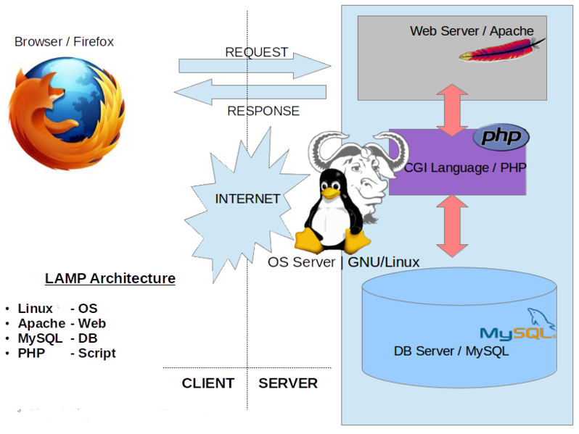


For server-side scripting: LAMP

Slide 12
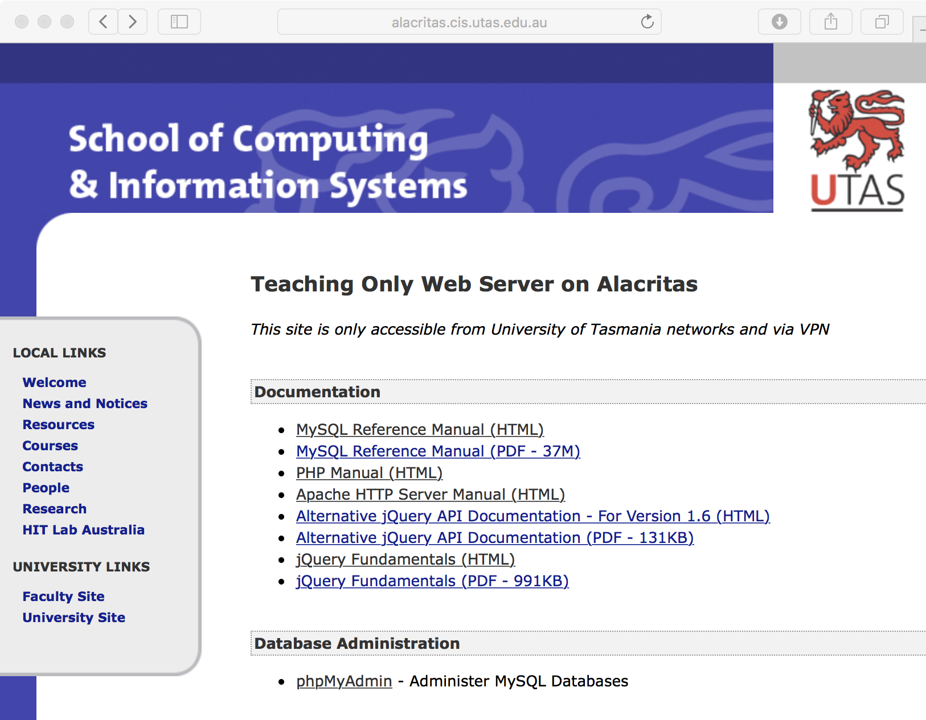

Slide 13
PHP?
created PHP in 1994 by Rasmus Lerdorf
an HTML-embedded server-side scripting language commonly used on web servers
used to make web pages dynamic
PHP is an interpreted language
generates HTML and/or other resources and send them to client browsers

Slide 14
Why PHP?
Easy to use
simple and easy to learn
lots of built-in functionality
can use a number of different editors
similar syntax to C / C++ / Java / JavaScript …
Open source
Anyone can run a PHP-enabled server.
Multiple platform
Support for databases

Slide 15
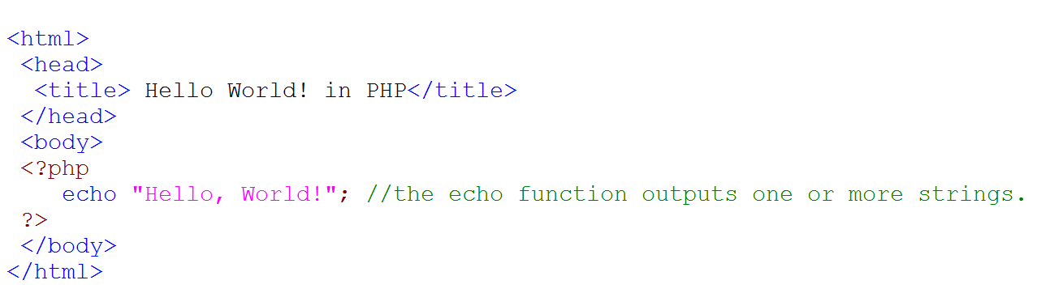
Starting PHP
PHP code embedded as blocks in HTML
The PHP script starts with a <?php or <? tag and end with ?>.
Between these tags, all statements end with a semicolon (;).

Slide 16
How to use PHP
Save as PHP file (i.e. index.php):
PHP file should save into the server:
For instance, the school server
alacritas.cis.utas.edu.au/~username/

Slide 17

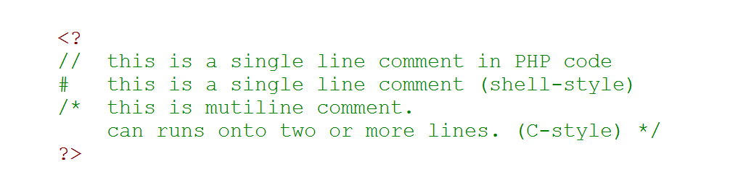
PHP : basic programming
Same commenting styles of Java, C++ and etc.
// : for single line comments
# : for single line comments
/* … */ : for multiline comments
Name of files containing PHP codes
usually uses .php as a file extension.
BTW, Soonja What is this?
<!- - - ->

Slide 18
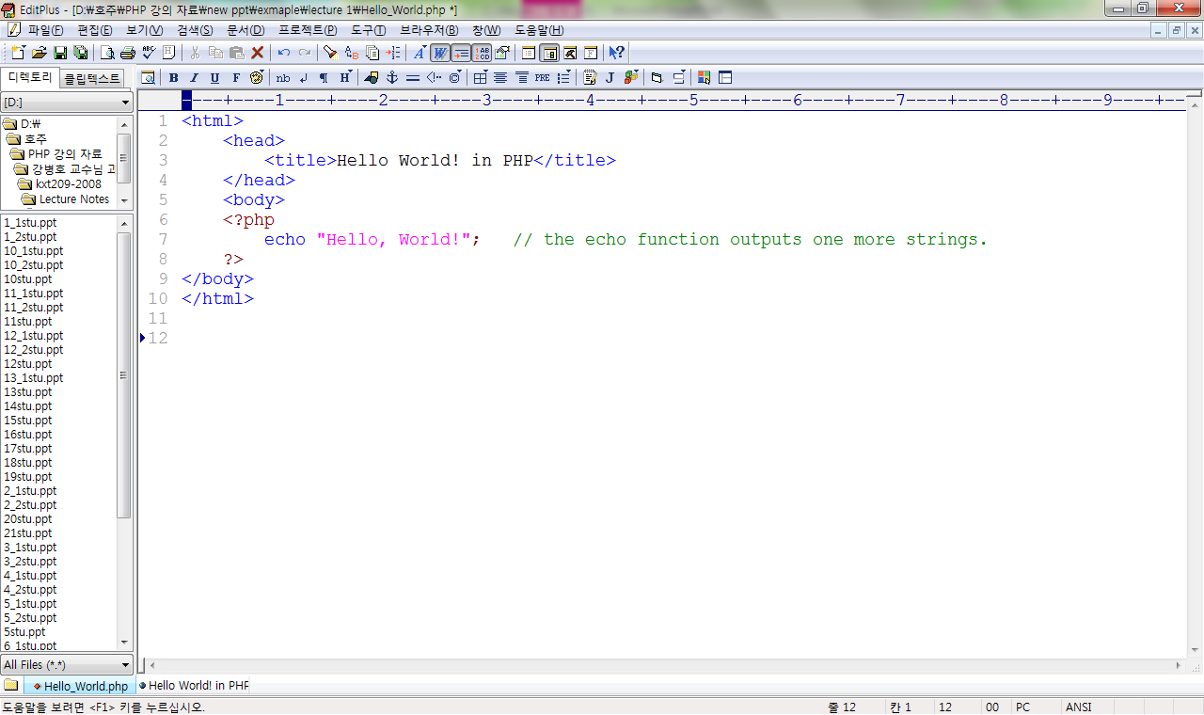
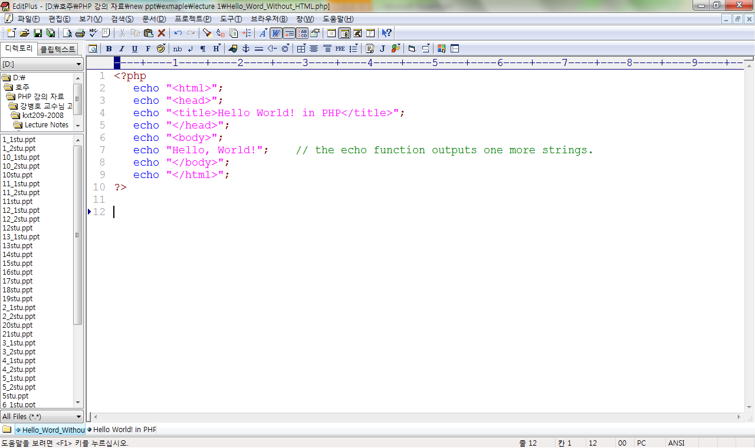
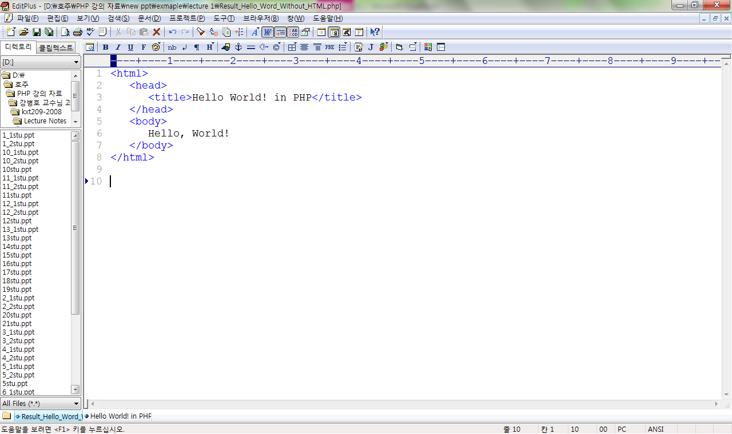
PHP : output
18
Server
PHP Interpreter
Client

Slide 19
PHP Basic
<?php
insert code here
?>
1. PHP blocks
2. Commenting
3. Rich collection of built-in resources.
more than 700 built-ins functions are available in PHP
// This is a comment.
/* Commenting your code will help you and others understand. */

Slide 20
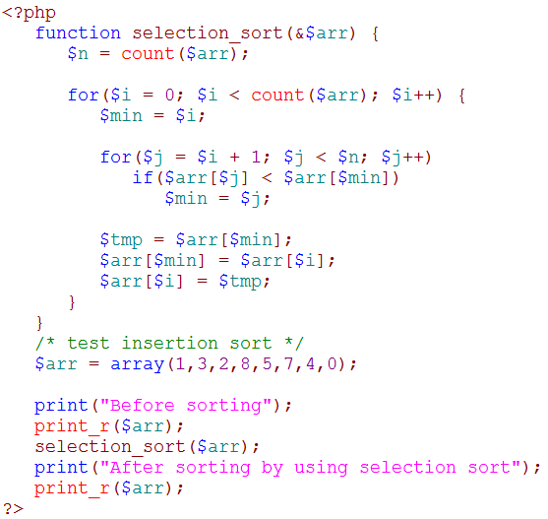
Overview of PHP Syntax
1.variable
1.
4.
3.
3.operator
4.control structure
5.function
2.
2.array

Slide 21
PHP Syntax (1) : Variable
Variable
$var = “variable”;

Slide 22


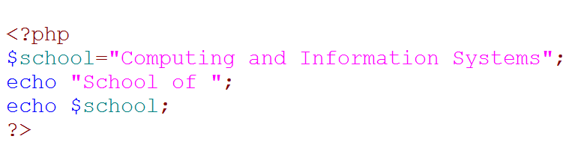
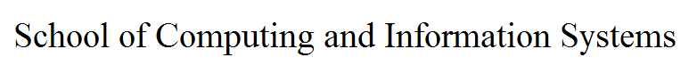
Variables
math | php
x=5, y=6, z=x+y | $x=5; $y=6; $z=$x+$y;

Slide 23
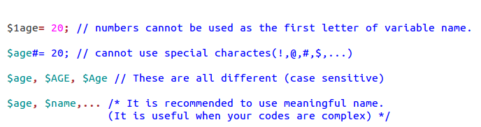
Valid variable names
Special characters | Meaning
\n | New line
\r | Carriage return [Enter]
\\ | \
\t | [Tab]
\” | “
\$ | $

Slide 24
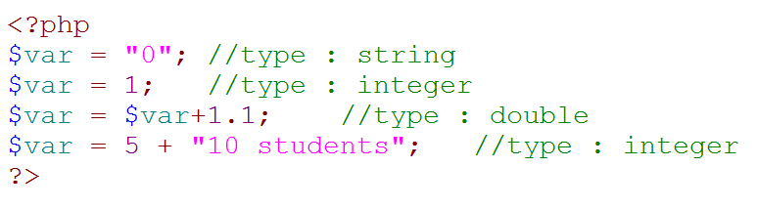
Types of Variables
String
Integer
Double or Float

Slide 25
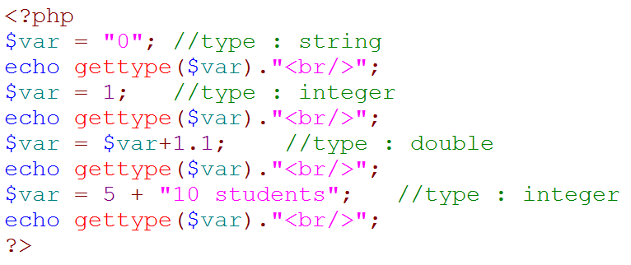
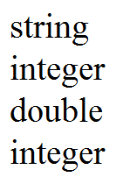
Types of Variables
gettype()
check the type of variable by using gettype() (built-in function)

Slide 26
Type juggling
Variable
Type of a variable in PHP
- determined by assigned value
- automatic type conversion
Data type can be changed differently from what you were expecting while program runs with on mixed types
<?php $x = “temp"; $y = 1 + $x; print ( "y = $y" ); ?>
1temp
1

Slide 27
Type casting
Variable
Type conversion or Typecasting
change an entity of one data type into another
Two ways to cast a variable
'(‘type’)’
settype() function
$var = (int) 1.5 $var = (bool) 2.3
<?php $foo = "5bar"; // string $bar = true; // boolean settype($foo, "integer"); // $foo is now 5 (integer) settype($bar, "string"); // $bar is now "1" (string) ?>
$var = settype( 1.5, “int" ); $var = settype( 2.3, “bool" );

Slide 28
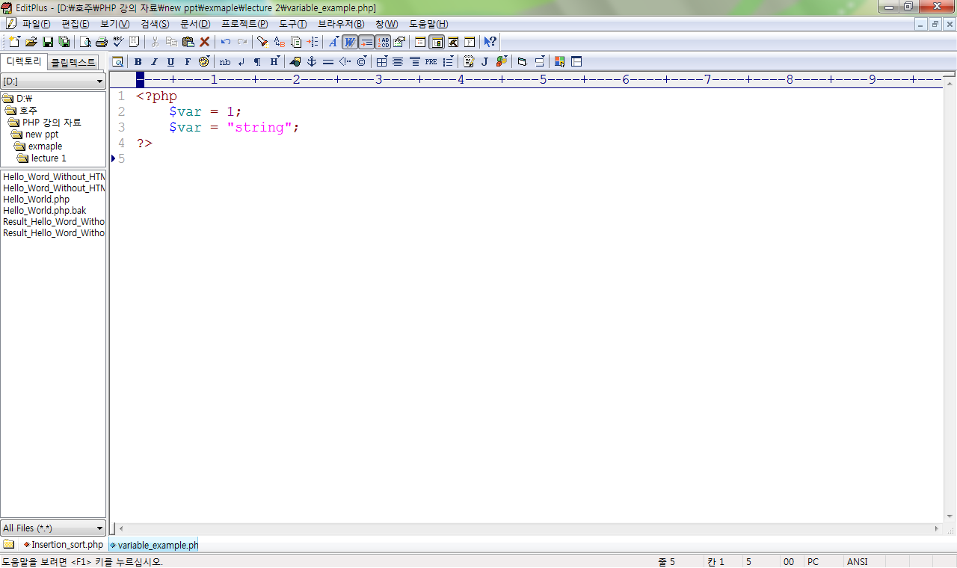
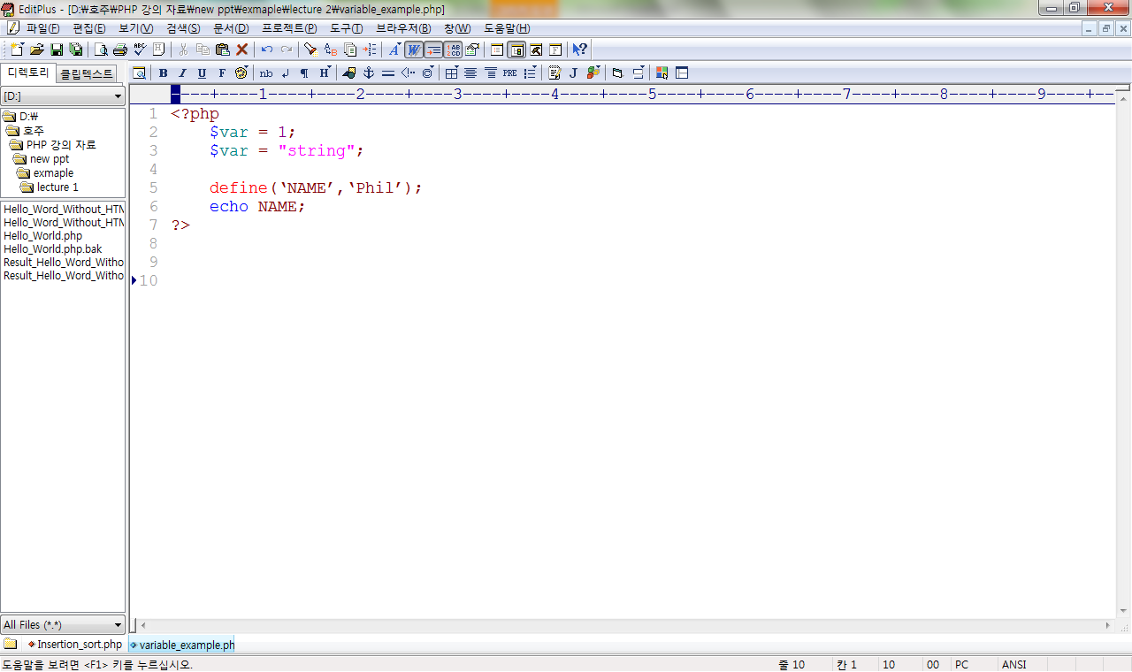
Unchangeable Variables
Variable
Flexible type (Loosely typed)
determined by the value assigned Type may change as the program executes. (Integer, String, Double or Float)
Constants (unchangeable variables)
Each constant is given a name (note no preceding dollar($) is applied here).

Slide 29
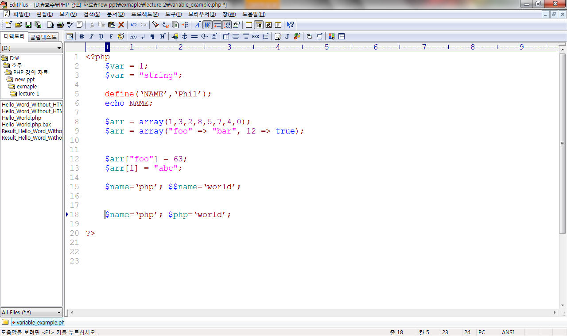
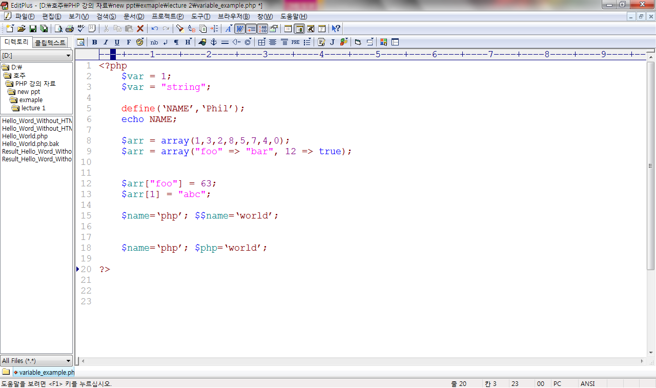
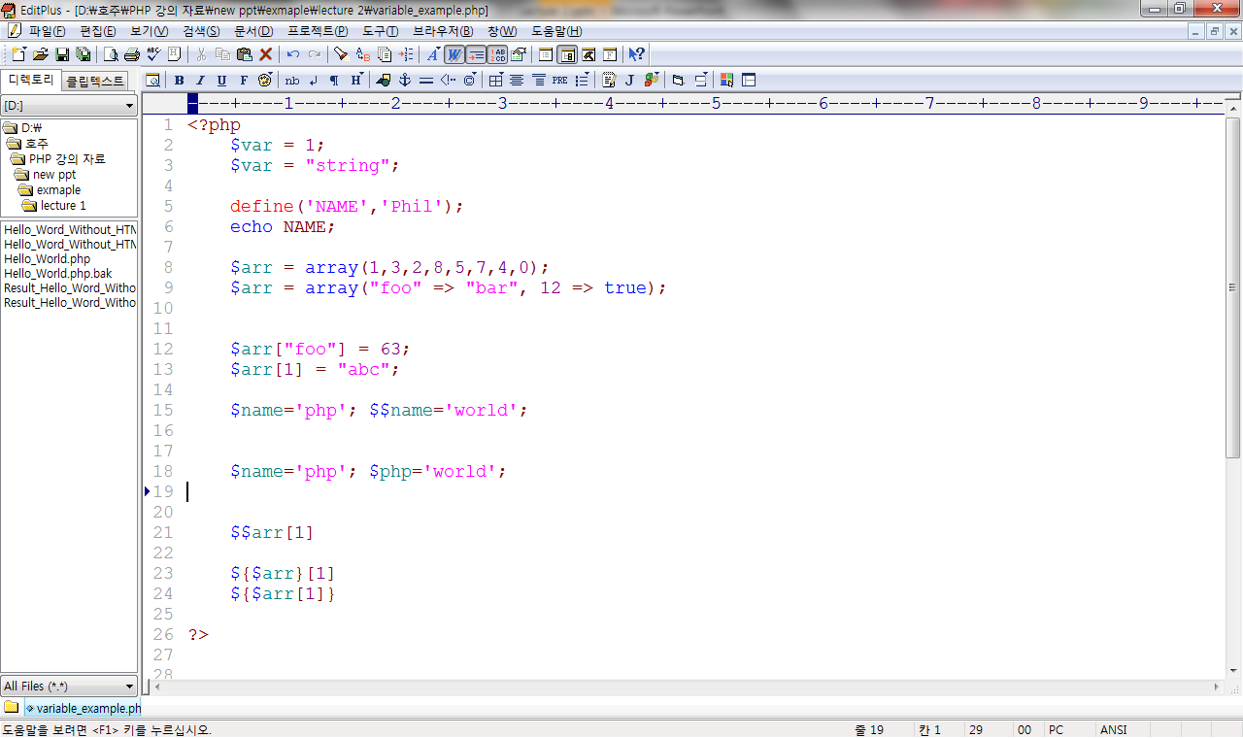
Variables
Variable
Variable variables
- variable name can be set and used dynamically
Ambiguity problem
- To resolve ambiguity uses {}.

Slide 30
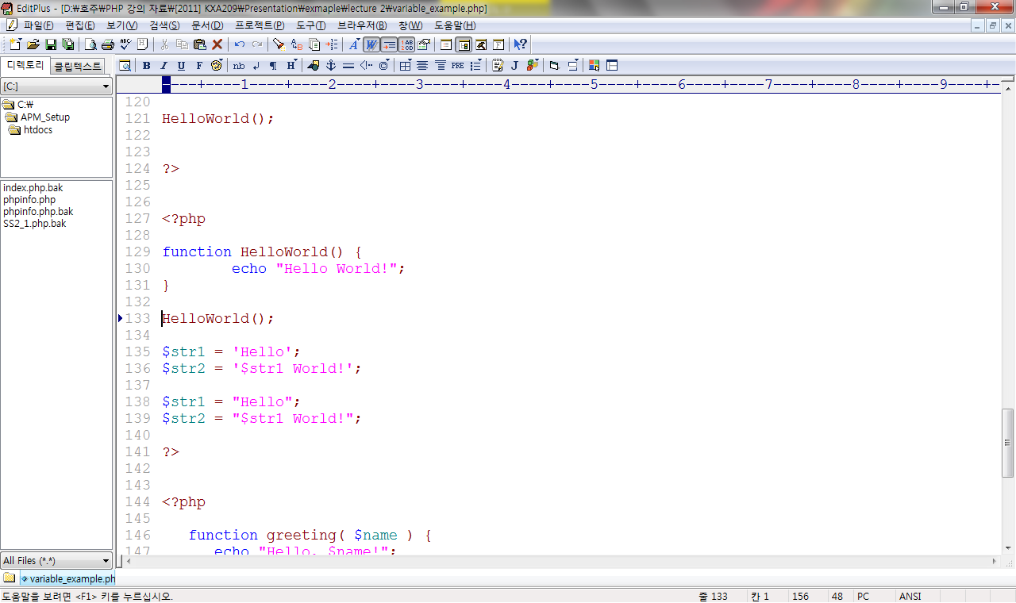
String in PHP
Variable
Two methods to set a string
single quotes
double quotes
$str1 World!
print( $str2 );
Hello World!

Slide 31
PHP Syntax (2): Array
2. Array
$arr = array(1,2,3,4,5);

Slide 32
Array
A set of variables contained as a group.
Array declaration
$array = array(1, 2, 3, 4);
foreach( $array as $value){
echo $value;
}
index
$array[0] = “1”;
$array[1] = “2”;
$array[2] = “3”;
$array[3] = “4”;
value

Slide 33
Array
Specifying index
beginning-index can be defined by programmer
index can be skipped
$array = array(1 => ‘Monday’, ‘Tuesday’, ‘Wednesday’);
array{
[1] => Monday
[2] => Tuesday
[3] => Wednesday }
$array = array(‘Sunday’, 3 => ‘Wednesday’);
array{
[0] => Sunday
[3] => Wednesday }

Slide 34
Array types
Numeric array
Associative array
$rainbow[0] = “red”;
$rainbow[1] = “orange”;
$rainbow[2] = “yellow”;
$rainbow[3] = “green”;
Numeric index
$studentID[‘John’] = “123456”;
$studentID [‘Tom’] = “234567”;
$studentID [‘Dave’] = “345678”;
$studentID [‘Mike’] = “456789”;
String index

Slide 35
Array types
Multidimensional array
array can be used as an index
Main array Sub array 1 Sub array 1-1
Sub array 1-2
Sub array 2 Sub array 2-1
$meal = array(
“John” => array(
“breakfast” => “cereal”,
“lunch” => “sandwich”,
“dinner” => “steak”,
),
“Tom” => array(
“breakfast” => “pancakes”,
…

Slide 36
PHP Syntax (3) : Operator
3. Operator
+, -, *, /, +=, ==, !=, >, <,…

Slide 37
Operator
Types of operator in PHP
● assignment
● arithmetic
● comparison
● logical (bitwise)
● incrementing / decrementing
● conditional
● string

Slide 38
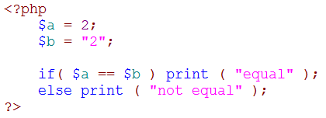
Unique operator in PHP
comparison
- <> : not equal
- === : identical (same value and type)
- !== : not identical
logical
- and
- or
- xor
string
- . : concatenate
equal

Slide 39
PHP Syntax (4) :Control Structure
Control Structure
4. Control Structure
for($i=1;$i<n;$i++){ }
while($i<n){ }
if(a==b){ }
● ● ●

Slide 40
Control structure
Decision control structures
- If / else / else-if statement
- switch statement
Repetition control structures
- while / do-while statement
- for / foreach statement
Branching statements
- break
- continue
- return

Slide 41
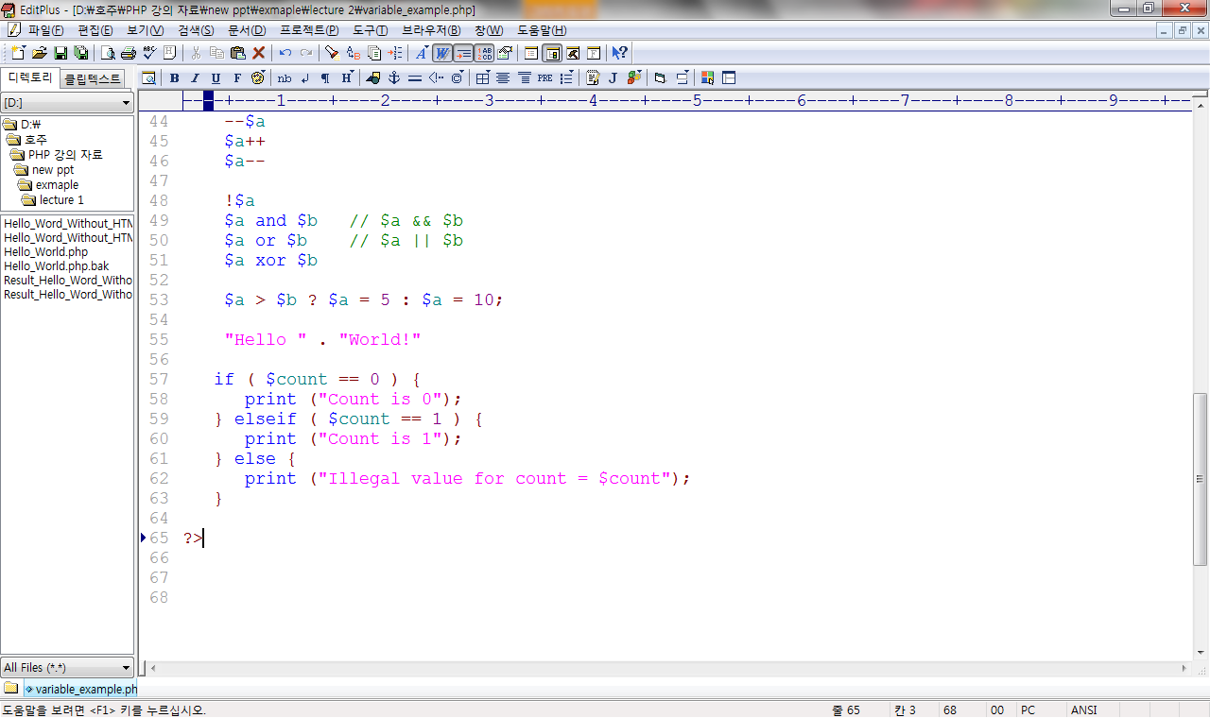
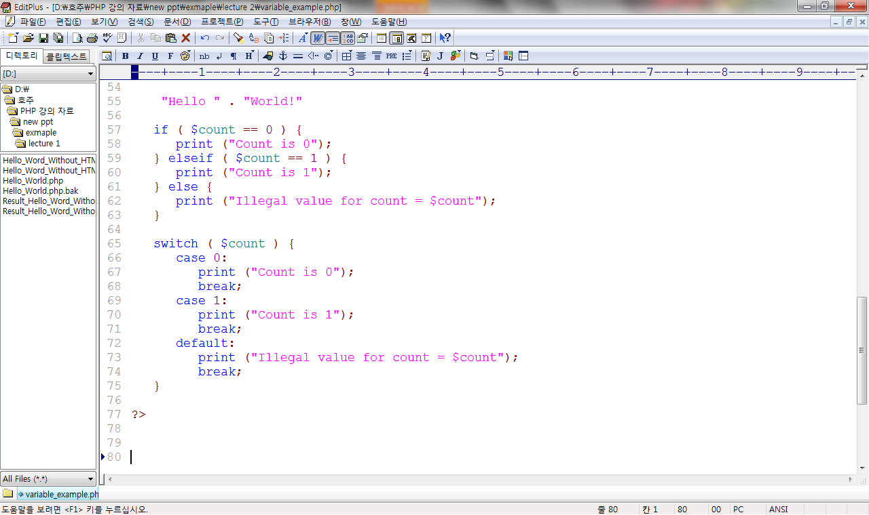
Decision control structure
if / else / else-if Statement
switch statement

Slide 42
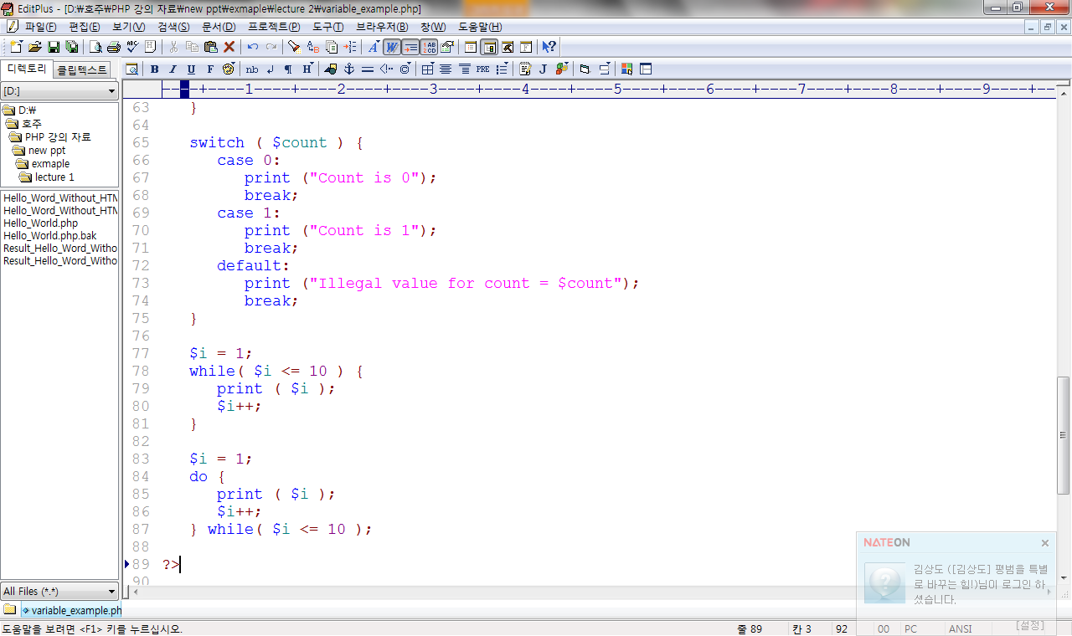
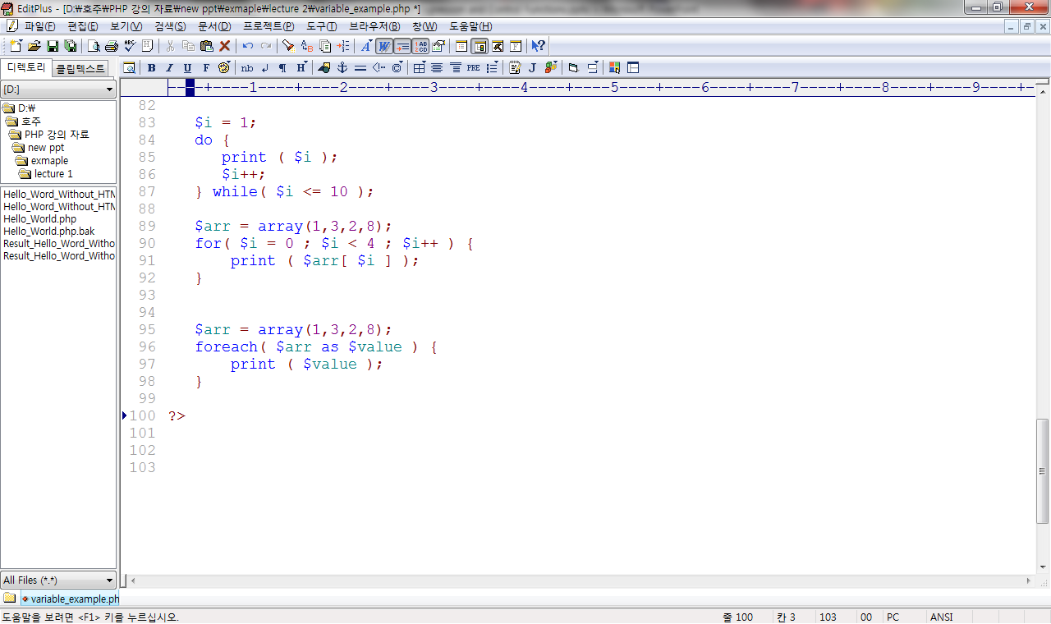
Decision control structure
while / do-while statement
for /foreach statement

Slide 43
PHP Syntax (5) : Function
5. Function
function Hello ($greetings) {
● ● ●
}

Slide 44
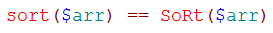
Function
Function
PHP function
- supports both built-in and user-defined functions
- types of parameter passing
pass by value, pass by reference
- multi-value returning
any variable type
- case-insensitive for function name
- supports recursive calls

Slide 45
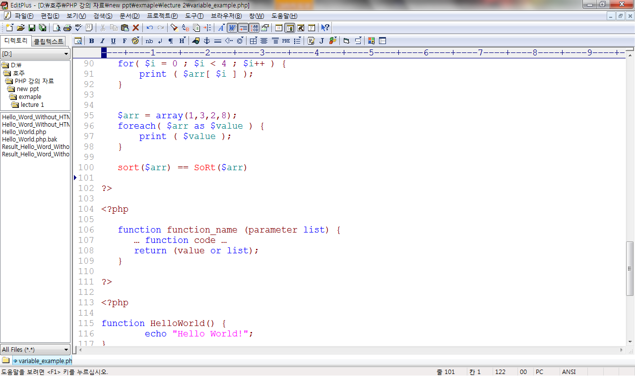
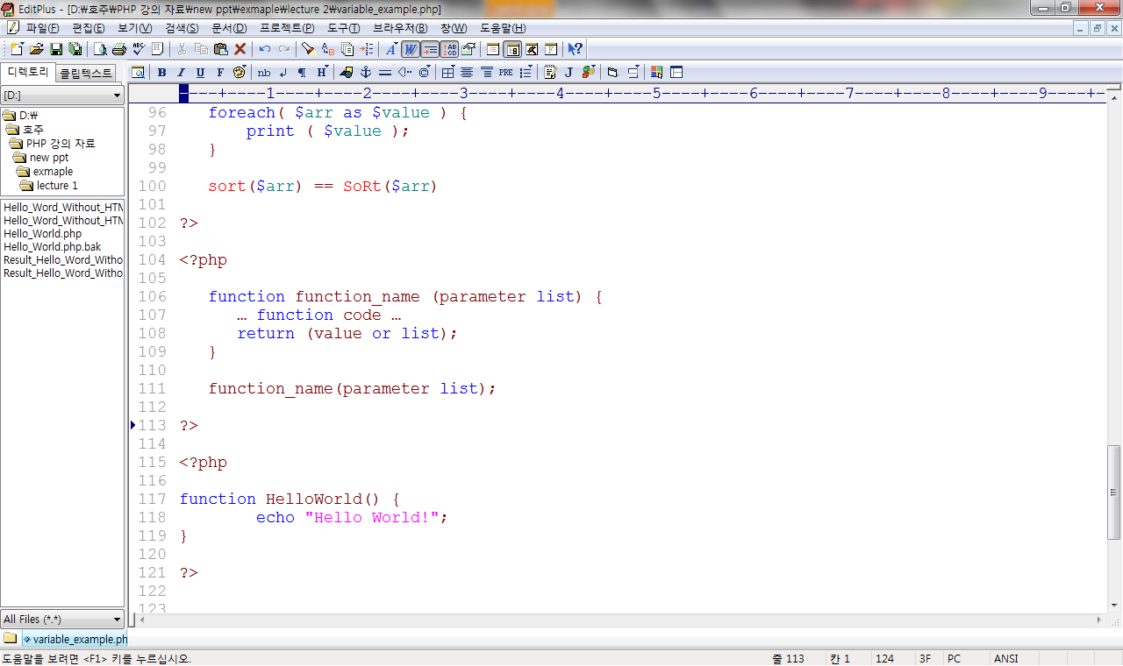
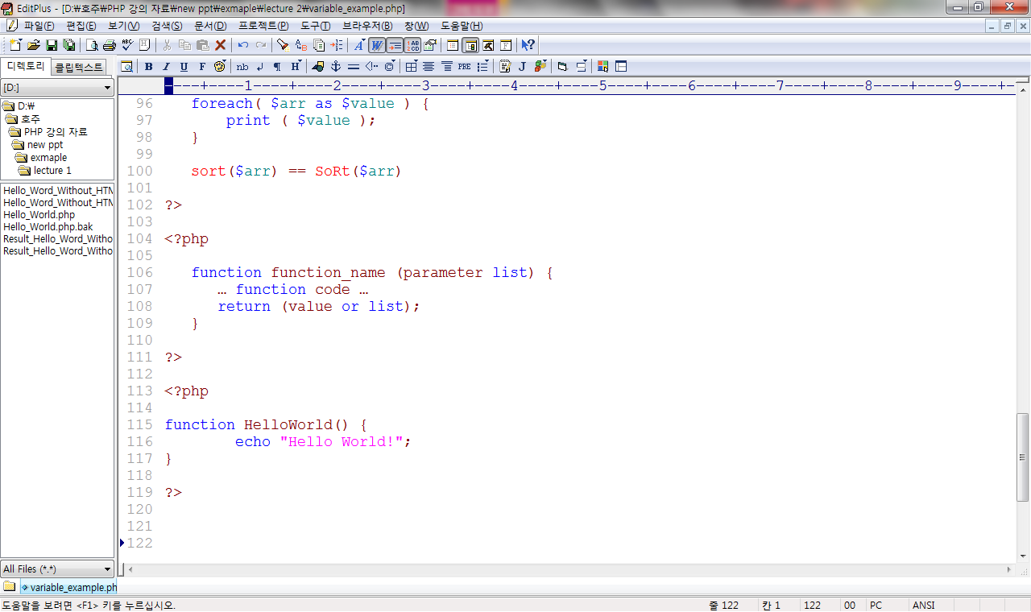
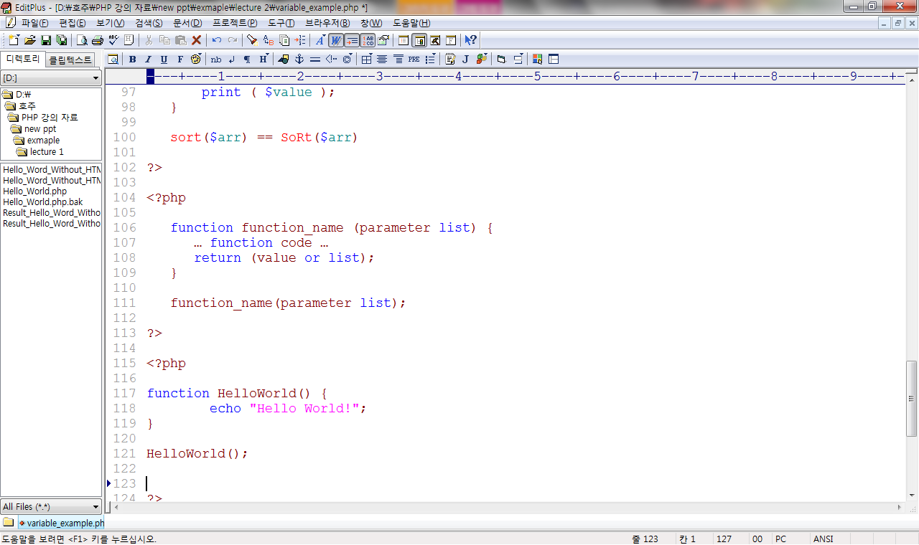
User defined function
Function
Function Definition
Function Call
Example

Slide 46
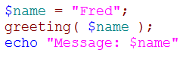
Pass by value/reference
Function
Pass by value
Pass by reference
function greeting( $name ) { echo "Hello, $name!"; $name = "done"; }
Hello, Fred!
Message: Fred
function greeting( &$name ) { echo "Hello, $name!"; $name = "done"; }
Hello, Fred!
Message: done

Slide 47
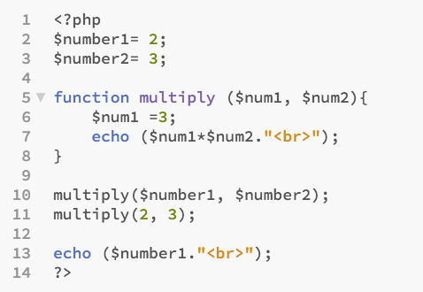
Guess output?

Slide 48
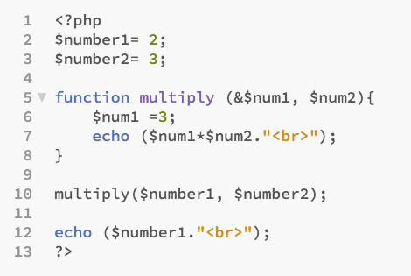
What about this?

Slide 49
Variable scope
Function
Variables are normally only visible inside the scope in which they are defined.
global variables are not visible inside functions
To access a global variable inside a function, it must be “imported”
Superglobal variables are autoglobal variables.
$a = 45; function someFunc() { global $a; print $a; }
$a = 45; function someFunc() { print $GLOBALS[‘a’];; }

Slide 50
Static Variable
Function
Normally, variables created in a function are destroyed after the execution.
Static variables
- are not deleted when a function terminates
- they are initialised on the first call to the function
- they retain their previous value on a subsequent call
function someFunc() { static $a = 0; print $a; $a++; }

Slide 51
Super-global variable
built-in variables containing information from Web server, environment and user input
- associative arrays
- global variable
- cannot be created by programmers
Example
- $_SERVER
an array containing information such as headers, paths, and script locations
- $_COOKIE
variables provided to script via HTTP cookies

Slide 52
Super-global variable
Example
- $_ENV
variables provided to script as part of the server environment.
- $_GET
variables provided to script via GET method.
- $_POST
variables provided to script via POST method.
- $_FILES
variables provided to script via file uploads.
- $_SESSION
variables registered in a session.

Slide 53
Built-in functions
Function
PHP has lots of built-in functions.
Array Functions i.e. array(), array_merge(), array_values()...
String Functions i.e. array(), array_merge(), array_values()...
DB Connectivity Functions i.e. mysql_connect(), mysql_query(), mysql_num_rows()...
Date and Time Functions i.e. date(), time(), mktime(), checkdate()...
File System Functions i.e. fopen(), fread(), fwrite(), mkdir()...
More built-in functions are available in PHP.

Slide 54
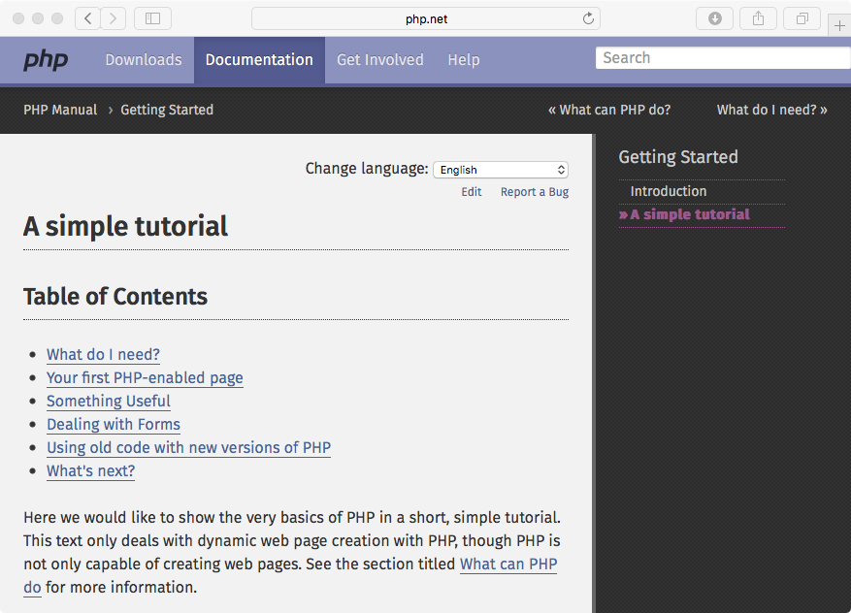
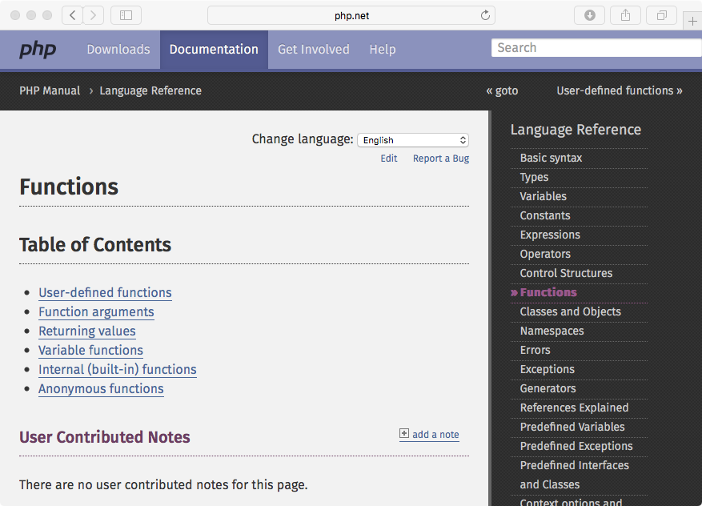
Built-in functions : php manual
http://php.net/manual/en/tutorial.php
http://php.net/manual/en/language.functions.php

Slide 55
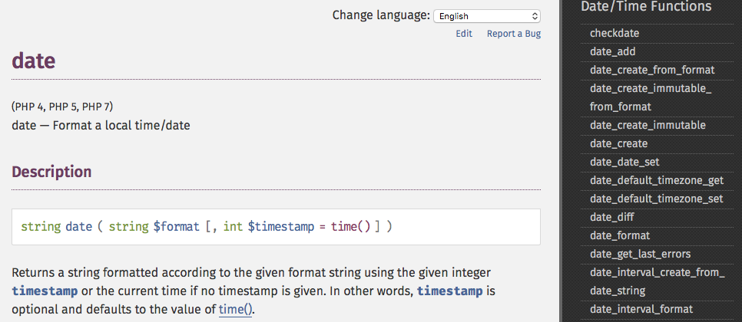
For example, date();
http://php.net/manual/en/function.date.php

Slide 56
date() & time()
date() and time() functions are based on Unix Epoch (January 1 1970 00:00:00 GMT)
0 of Timestamp is the Unix Epoch (January 1 1970 00:00:00 GMT).
time() function calculate the seconds since the Unix Epoch (January 1 1970 00:00:00 GMT).
.
$date=date(“Y-m-d H:i:s”);
echo $date;
$date=date(“Y-m-d H:i:s”,1234567890);
echo $date;
$time=time();
echo $time;
timestamp

Slide 57
Built-in Function: File Inclusion
require() & include()
Allow people to reuse any type of code in other files. - Variables are shared by main file and included(required) file
- Use for web site templates
● Footer and Header for Web pages
● auto_prepend_file, auto_append_file.

Slide 58
require() & include()
require()
- Format : require(filename)
● Footer and Header for Web pages
include() - Similar as require()
- more efficient :
● Only evaluated as the code is executed
- can return the value
NOTE: Require_once(); include_once();

Slide 59
Thank you
Any Questions

